Slide 1
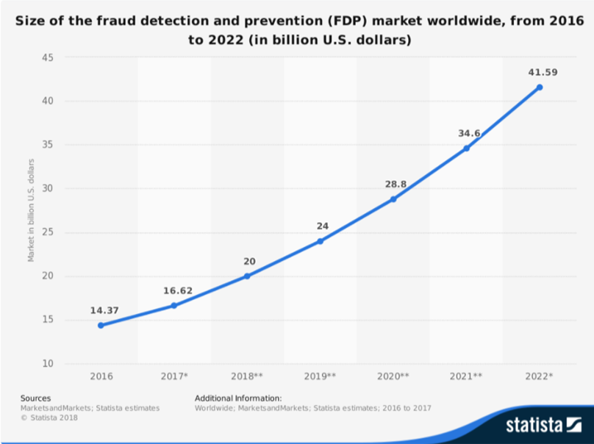
Fraud (anomalies) detection and prevention
One area that machine learning finds important applications is fraud detection. With such large sums of money at stake, it is easy to see why.
According to Statista, in 2017, the global FDP (fraud detection and prevention) market was estimated to be worth $16.6 billion.

Slide 2
Fraud detection and prevention
Areas where fraud detection and prevention are applied include insurance claims, money laundering, electronic payments, and bank transactions, both online and offline.
The challenge is to quickly identify and separate anomalous transactions from those that are legitimate, without impacting on customer experience.
Note that companies are also suffering because of lost sales when genuine transactions are declined by fraud management systems.

Slide 3
Fraud detection and prevention
How can Machine learning help?
Before Computer: Banks and financial institutions analyzed their customers’ behavioral patterns for any signs of abnormality, and designed checking rules to “flag” abnormal transactions manually.
After Computer: Computers gave them the ability to identify and flag abnormal transactions in real-time.
After ML: Machine learning tools ‘learn’ new patterns, without the need for human intervention. This allows models to adapt over time to uncover previously unknown patterns or identify new tactics that might be employed by fraudsters.

Slide 4
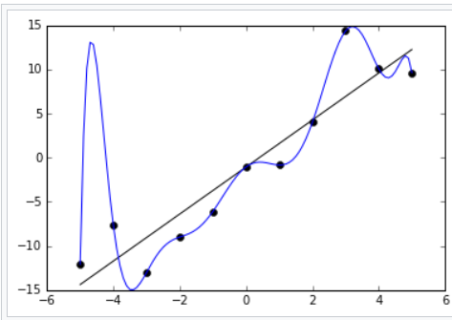
Fraud detection and prevention
Key for ML’s success:
High accuracy
small number of false negatives
small number of false positives
Avoid overfitting
We build the ML model based on some dataset
The model may have very high accuracy for this dataset, but very low accuracy in general.
The data points are all on the black straight line, but
the few data points we used to build our model (blue
line) do not fall on the line because of noises. Our blue
line model has serious overfitting problem:
‘fit’ extremely well for our data point, but
has very low accuracy in general.

Slide 5
Fraud detection and prevention
There are many good free ML learning tools available (e.g., from scikit-learn, TensorFlow)
These tools have their own strengths and weaknesses.
We need to pick the right tool for our application (e.g., high accuracy, small overfitting).
Even we have picked the right tool, our dataset must be large enough and up-to-date so that we can train the right model.

Slide 6
An example on ML fault prevention: Money Laundering
The problem is difficult because
the offenders are legitimate users too,
just detect and give a ‘red flag’ for a fraud transaction that has already happened may not help much; the user may have fled by the time the fraud is detected.
We need to detect and prevent abnormal transactions from happening in real time.
We can use ML to learn those common characteristics (patterns) of the fraud transactions from money launderers and other hackers
For any new transaction, we use our machine learning tool to detect these patterns automatically, and to alert us immediately when it detects abnormal transactions.

Slide 7
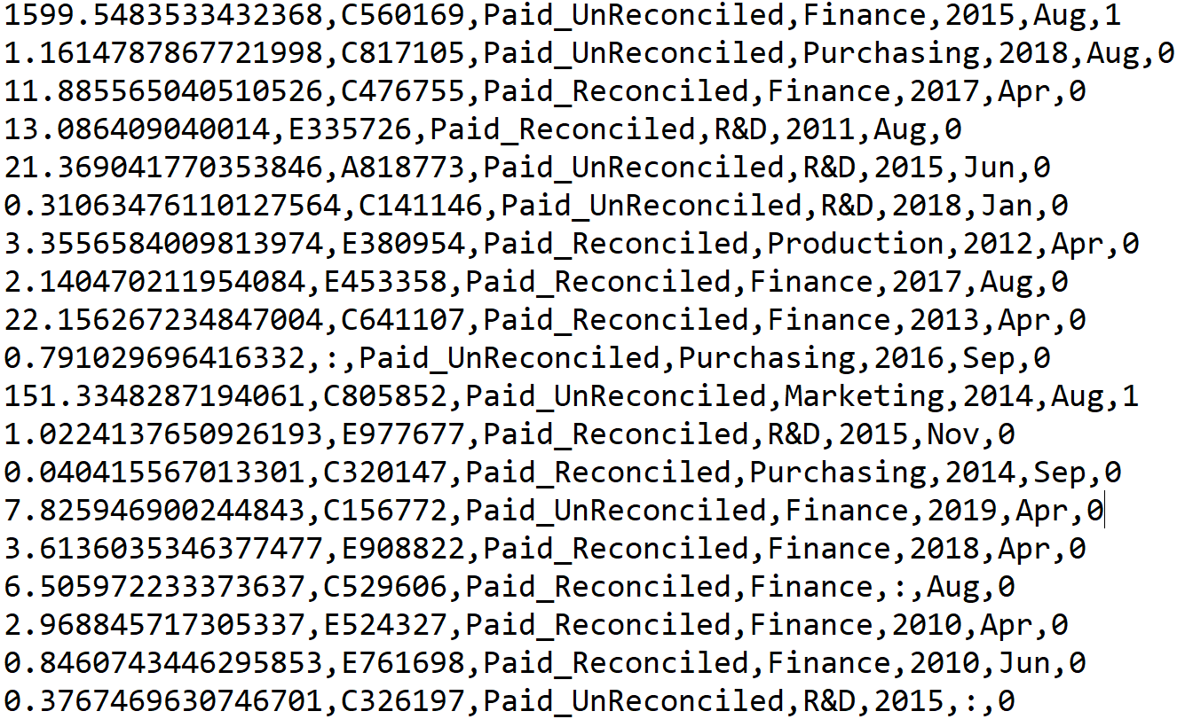
The dataset
Based on the following transaction file: tranrecords.csv
The csv if for the “comma-separated-values” format

Slide 8
The dataset
Based on the following transaction file: tranrecords.csv
The csv if for the “comma-separated-values” format
Missing value

Slide 9
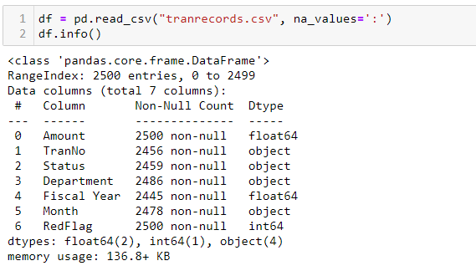
pandas has a simple method for reading cvs file

Slide 10
pandas has a simple method for reading cvs file
‘:’ represents
missing values
(null values for
these entries)

Slide 11

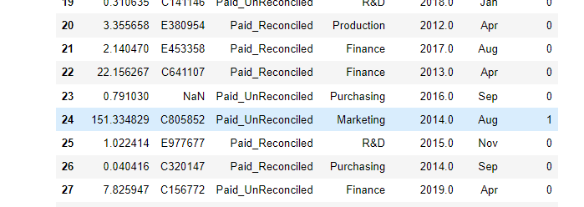
Know your data

Slide 12
Know your data
Replace all ‘:’ entries
by a special value
NaN (Not a Number)

Slide 13
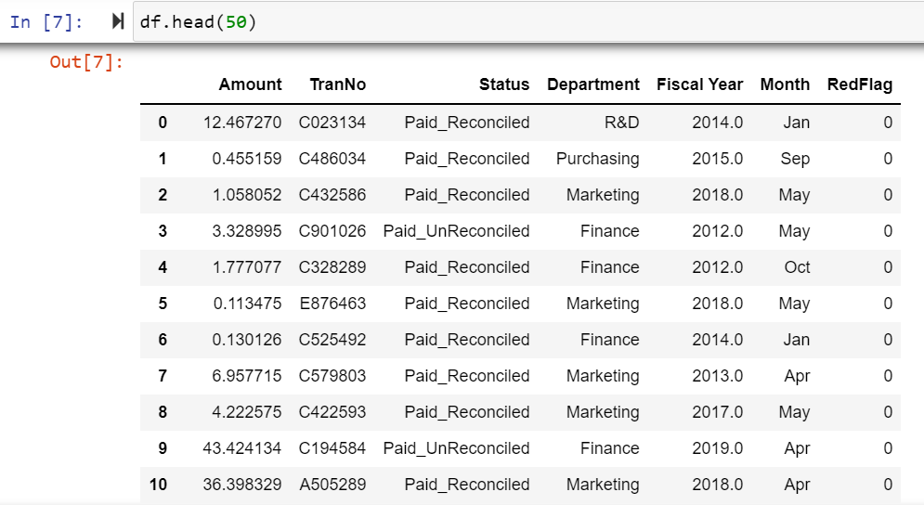
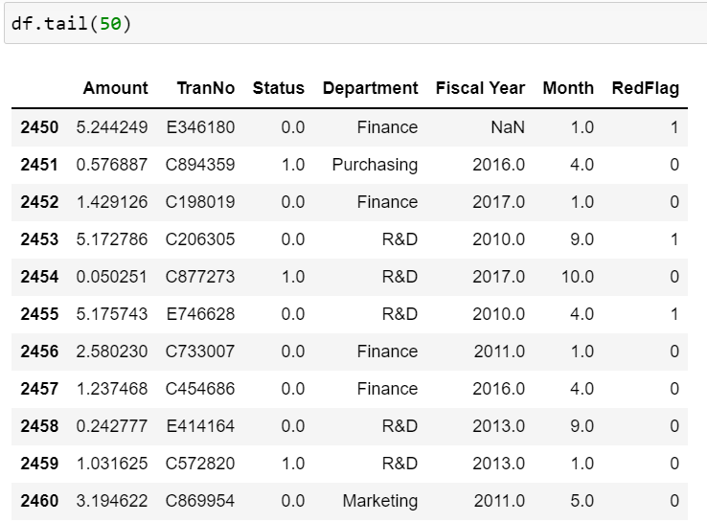
Know your data
Look at some samples of the data

Slide 14
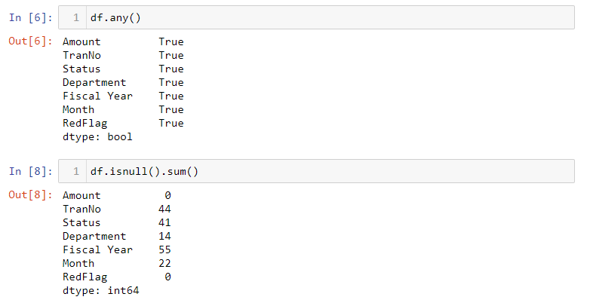
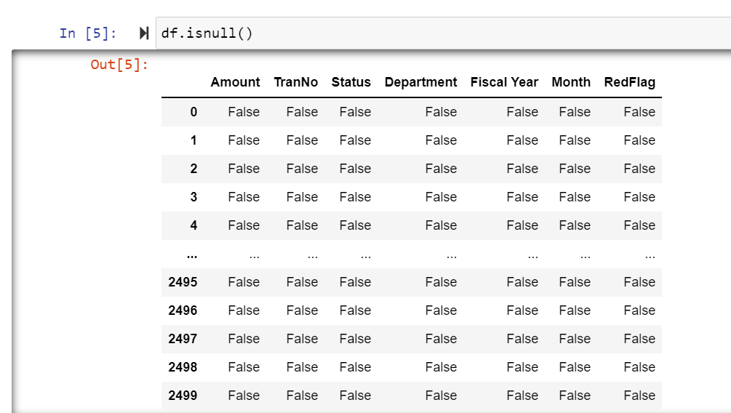
Know your data: Get some idea of missing values

Slide 15
Cleaning your data: Handling the missing values
To drop all the rows with missing values by executing
df.dropna()
To replace, for every missing value, by the mean of the column the missing value belongs.
df.fillna(df.mean())

Slide 16
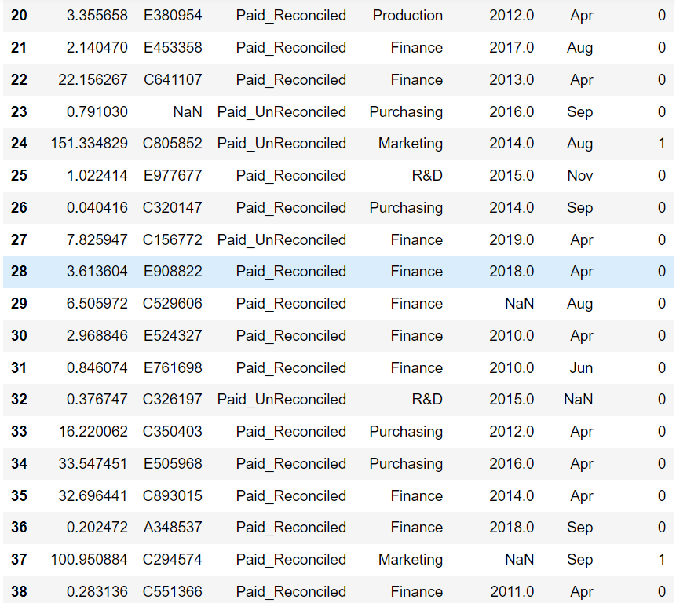
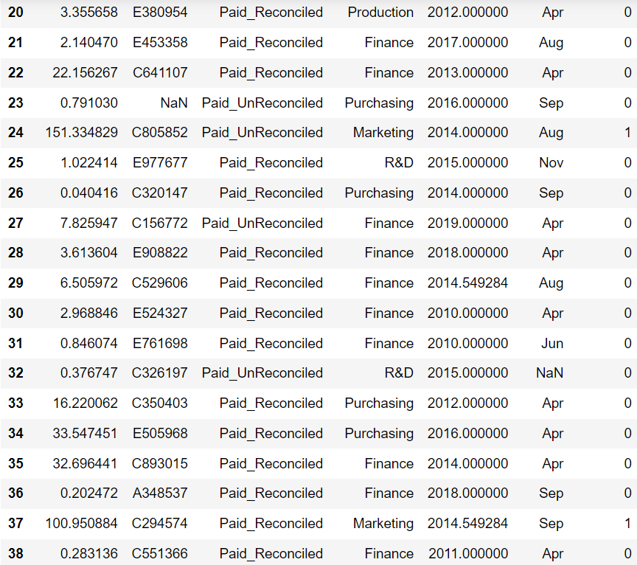
Cleaning your data: Handling the missing values

Slide 17
Cleaning your data: Handling the missing values
No change because
non-numeric values
do not have mean.

Slide 18
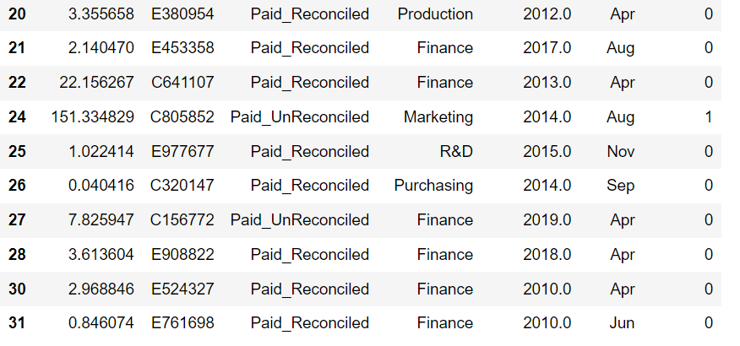
Cleaning your data: Handling the missing values
Delete the rows that cannot be handled in
the previous step.

Slide 19

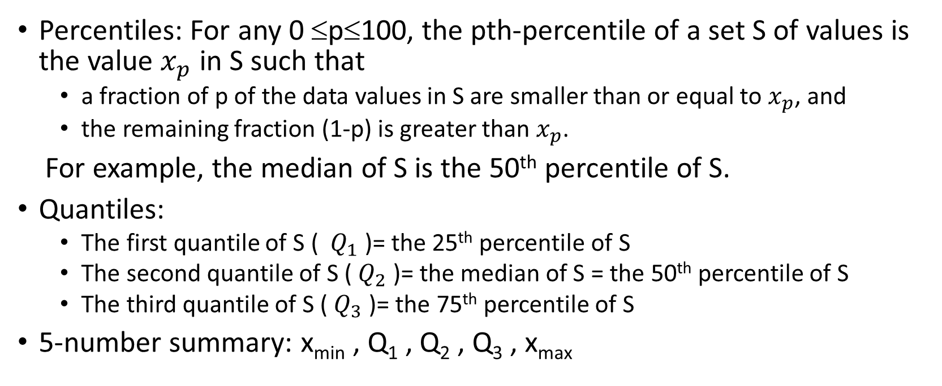


Cleaning your data: detecting outliers
Percentiles: For any 0 ≤p≤100, the pth-percentile of a set S of values is the value $x_{p}$ in S such that
a fraction of p of the data values in S are smaller than or equal to $x_{p}$, and
the remaining fraction (1-p) is greater than $x_{p}$.
For example, the median of S is the 50th percentile of S.
Quantiles:
The first quantile of S ( $Q_{1}$ )= the 25th percentile of S
The second quantile of S ( $Q_{2}$ )= the median of S = the 50th percentile of S
The third quantile of S ( $Q_{3}$ )= the 75th percentile of S
5-number summary: x_{min} , Q₁ , Q₂ , Q₃ , x_{max}
25%
$$Q_{1}$$
50%
$$Q_{2}$$
75%
$$Q_{3}$$

Slide 20
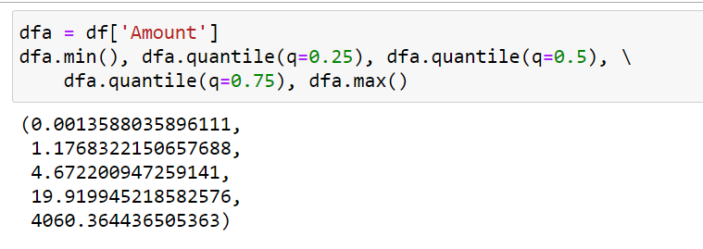
Cleaning your data: detecting outliers
Percentiles: For any 0 ≤p≤100, the pth-percentile of a set S of values is the value $x_{p}$ in S such that
a fraction of p of the data values in S are smaller than or equal to $x_{p}$, and
the remaining fraction (1-p) is greater than $x_{p}$.
For example, the median of S is the 50th percentile of S.
Quantiles:
The first quantile of S ( $Q_{1}$ )= the 25th percentile of S
The second quantile of S ( $Q_{2}$ )= the median of S = the 50th percentile of S
The third quantile of S ( $Q_{3}$ )= the 75th percentile of S
5-number summary: x_{min} , Q₁ , Q₂ , Q₃ , x_{max}
25%
$$Q_{1}$$
50%
$$Q_{2}$$
75%
$$Q_{3}$$

Slide 21
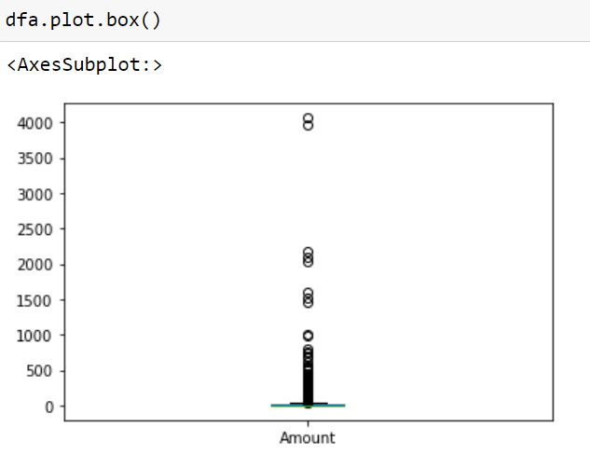
Cleaning your data: detecting outliers
Percentiles: For any 0 ≤p≤100, the pth-percentile of a set S of values is the value $x_{p}$ in S such that
a fraction of p of the data values in S are smaller than or equal to $x_{p}$, and
the remaining fraction (1-p) is greater than $x_{p}$.
For example, the median of S is the 50th percentile of S.
Quantiles:
The first quantile of S ( $Q_{1}$ )= the 25th percentile of S
The second quantile of S ( $Q_{2}$ )= the median of S = the 50th percentile of S
The third quantile of S ( $Q_{3}$ )= the 75th percentile of S
5-number summary: x_{min} , Q₁ , Q₂ , Q₃ , x_{max}

Slide 22
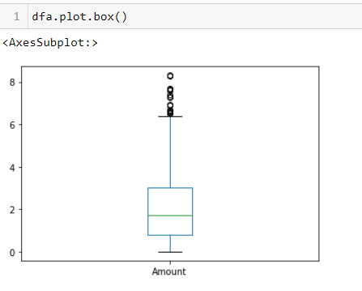
Cleaning your data: detecting outliers
Percentiles: For any 0 ≤p≤100, the pth-percentile of a set S of values is the value $x_{p}$ in S such that
a fraction of p of the data values in S are smaller than or equal to $x_{p}$, and
the remaining fraction (1-p) is greater than $x_{p}$.
For example, the median of S is the 50th percentile of S.
Quantiles:
The first quantile of S ( $Q_{1}$ )= the 25th percentile of S
The second quantile of S ( $Q_{2}$ )= the median of S = the 50th percentile of S
The third quantile of S ( $Q_{3}$ )= the 75th percentile of S
5-number summary: x_{min} , Q₁ , Q₂ , Q₃ , x_{max}
For more “normal” data
The 5-number summary

Slide 23
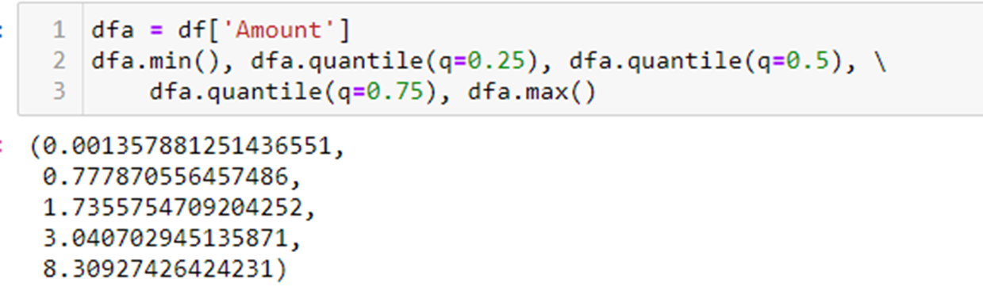
Cleaning your data: detecting outliers
Percentiles: For any 0 ≤p≤100, the pth-percentile of a set S of values is the value $x_{p}$ in S such that
a fraction of p of the data values in S are smaller than or equal to $x_{p}$, and
the remaining fraction (1-p) is greater than $x_{p}$.
For example, the median of S is the 50th percentile of S.
Quantiles:
The first quantile of S ( $Q_{1}$ )= the 25th percentile of S
The second quantile of S ( $Q_{2}$ )= the median of S = the 50th percentile of S
The third quantile of S ( $Q_{3}$ )= the 75th percentile of S
5-number summary: x_{min} , Q₁ , Q₂ , Q₃ , x_{max}
outliers

Slide 24
Statistics has a formal definition of outliers
Formal definition of outliers
Based on the 5-number summary: x_{min} , Q₁ , Q₂ , Q₃ , x_{max}
Define the interquartile range IQR to be the value Q₃ – Q₁
An outlier is the one with value either
<= (Q1 – 1.5 * IQR), or
>= (Q3 + 1.5 * IQR)
outliers

Slide 25
Statistics has a formal definition of outliers
What exactly are outliers?
Based on the 5-number summary: x_{min} , Q₁ , Q₂ , Q₃ , x_{max}
Define the interquartile range IQR to be the value Q₃ – Q₁
An outlier is the one with value either
<= (Q1 – 1.5 * IQR), or
>= (Q3 + 1.5 * IQR)
outliers
For most applications, we will throw away outliers as
they are usually caused by “noise”.

Slide 26
Cleaning your data: detecting outliers
Percentiles: For any 0 ≤p≤100, the pth-percentile of a set S of values is the value $x_{p}$ in S such that
a fraction of p of the data values in S are smaller than or equal to $x_{p}$, and
the remaining fraction (1-p) is greater than $x_{p}$.
For example, the median of S is the 50th percentile of S.
Quantiles:
The first quantile of S ( $Q_{1}$ )= the 25th percentile of S
The second quantile of S ( $Q_{2}$ )= the median of S = the 50th percentile of S
The third quantile of S ( $Q_{3}$ )= the 75th percentile of S
5-number summary: x_{min} , Q₁ , Q₂ , Q₃ , x_{max}
outliers
But for our case, outliers are important because
they give signals for possible fraud transactions

Slide 27
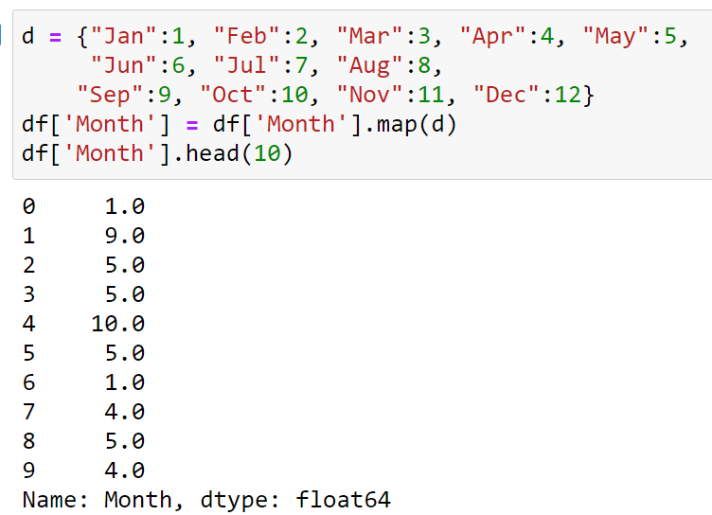
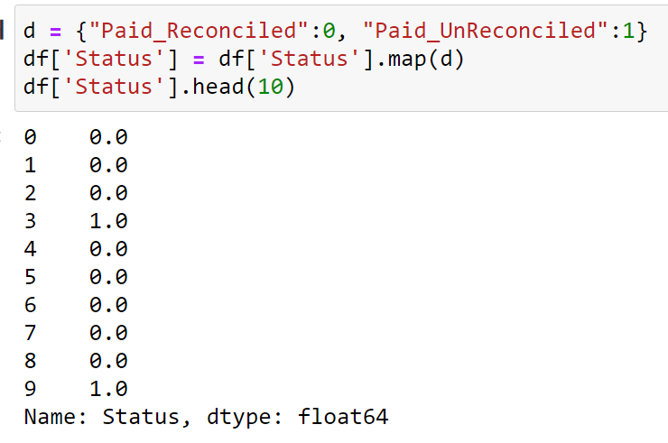
Preparing the data set: convert to numeric values
Most ML model building methods require numeric inputs, but our data set has several columns with non-numeric values, e.g., ‘Month’, ‘Status’. We need to map these non-numeric values to numeric ones.

Slide 28
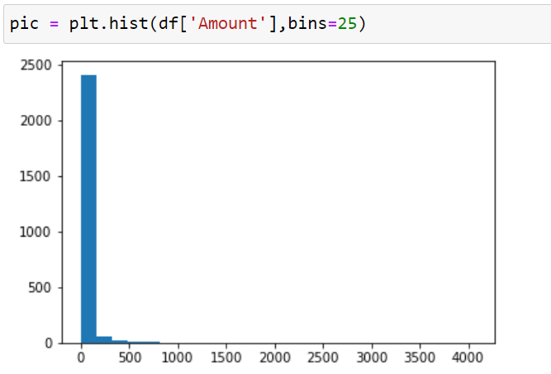
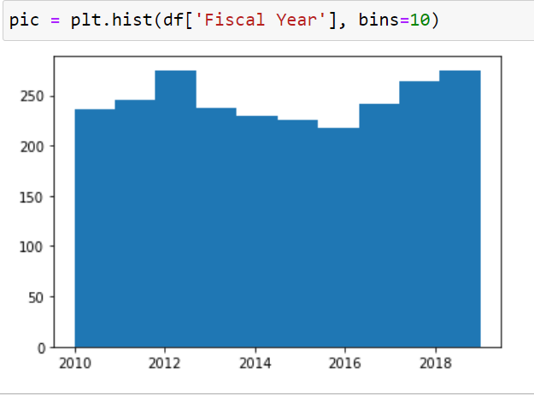
Preparing the data set: distributions of data

Slide 29
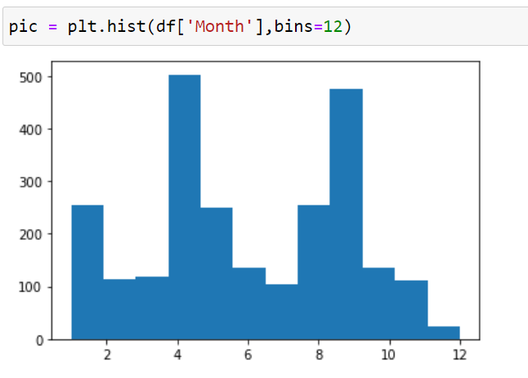
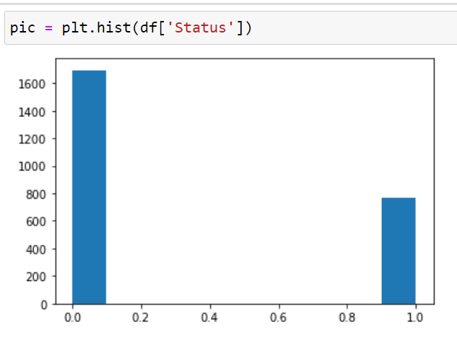
Preparing the data set: distributions of data

Slide 30
Preparing the data set: transformation of data
The distribution of df[‘Amount’] is very skewed, and the values of its outliers are much larger than the “normal” values.
This kind of distribution is not suitable for most ML method.
We may transform the data to an “equivalent” one that is more “normal”.

Slide 31
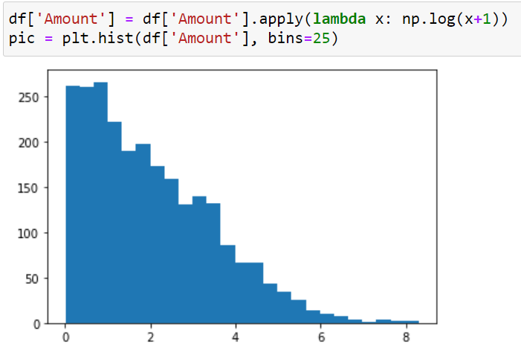
Preparing the data set: transformation of data
We use log-transformation here.

Slide 32

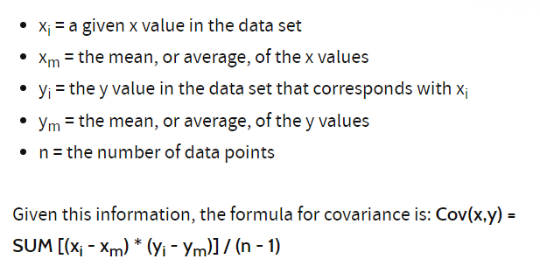
Choosing the columns (i.e., “features”) for ML
We compute, for each column, the compute the covariance of this column and the output column (i.e., the RedFlag column).
X, Y
Cov(X, X) (aka Variance(X)
Cov(X, Y)
Cov(Y, X)
Cov(Y, Y)
Note: Cov(X,Y) = Cov(Y,X)

Slide 33
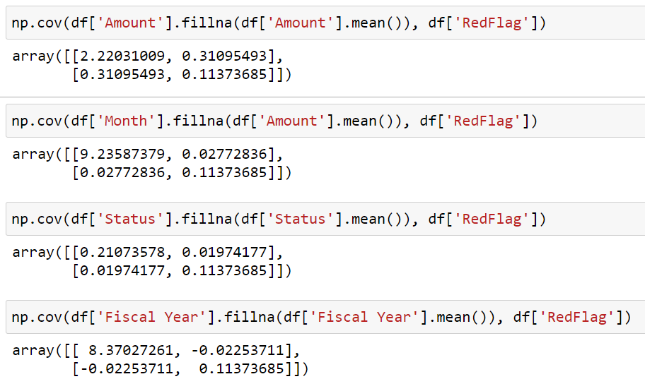
Choosing the columns (i.e., “features”) for ML

Slide 34
How to handle rare classes
It is expected that in our DS, there are only a small fraction of redflag transactions. If we sample the whole DS normally, a major of the training data are non-redflag, and this makes the ML model favor prediction of non-redflag. Thus, in our training dataset, the number of redflag and non-redflag inputs should be more or less equal.
How to do it? By oversamples. E.g. duplicate the redflag inputs in the DS to make the size non-redflag and redflag inputs more or less equal
But we have to do it carefully. There are many good methods.
Navie Random over-sample
ROSE: Random Over-Sample Examples
SMOTE: Synthetic Minority Oversample Technique
ADASYN: Adaptive Synthetic Method

Slide 35
We are now ready to apply the ML methods in SciKit-Learn to construct classifiers for detecting fraud transactions

Slide 36
We use the following ML methods from scikit-learn to construct classifiers
GuassianNB: To learn and construct a Guassian Naive Bayes classifier
LogisticRegression: To learn and construct Logistic Regression classifier
DecisionTreeClassifier: To learn and construct a Decision Tree classifier
RandomForestClassifier: To learn and construct a Random Forest classifier
SGDClassifier: To learn and construct a Stochastic Gradient Descent (SGD) classifier

Slide 37
We use the following ML methods from scikit-learn to construct classifiers
GuassianNB: To learn and construct a Guassian Naive Bayes classifier
LogisticRegression: To learn and construct Logistic Regression classifier
DecisionTreeClassifier: To learn and construct a Decision Tree classifier
RandomForestClassifier: To learn and construct a Random Forest classifier
SGDClassifier: To learn and construct a Stochastic Gradient Descent (SGD) classifier
The inputs of these classifiers are numbers in [0, 1].
Thus, we need to transform our data x to a number
[0, 1]. There are many ways to do this, and we will
use the minmax method:
x ➔ (x – min)/(max – min)

Slide 38
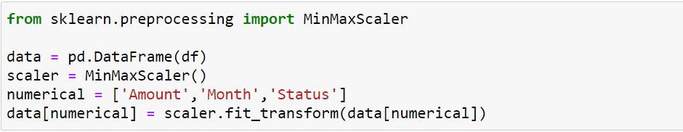
The inputs of these classifiers are numbers in [0, 1].
Thus, we need to transform our data x to a number
[0, 1]. There are many ways to do this, and we will
use the minmax method:
x ➔ (x – min)/(max – min)

Slide 39
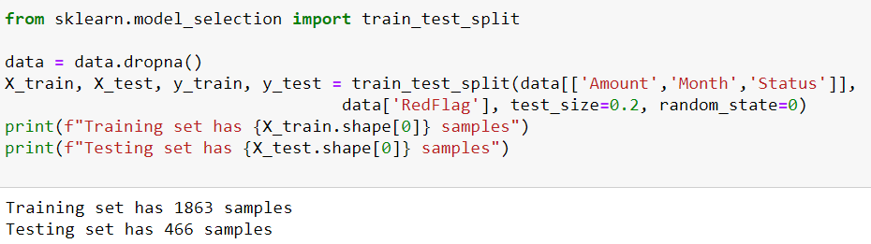

Slide 41
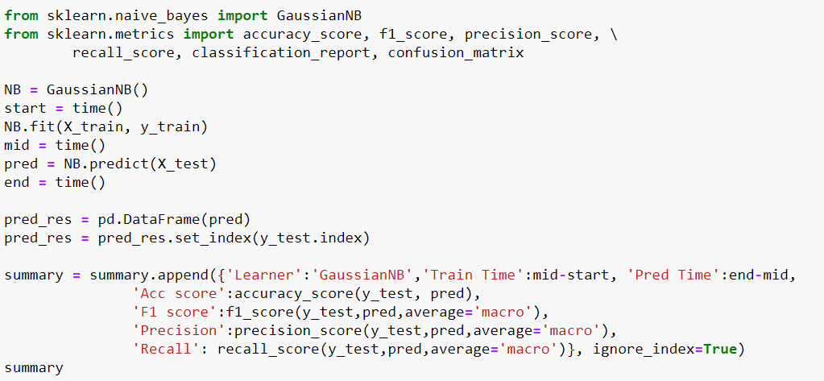


Slide 42
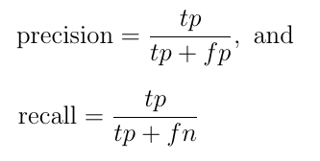
Definitions for Precision and Recall
Given a transaction, we say that it is a
true positive: ML predicts positive, and it is indeed redflag in our DS
true negative: ML predicts negative, and it is indeed no-redflag
false positive: ML predicts positive, but it is no-redflag
false negative: ML predicts negative, but it is redflag

Slide 43
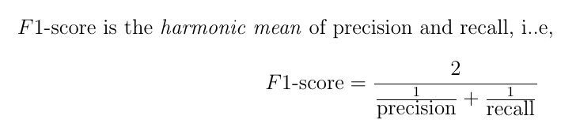
Definitions for Precision and Recall
Given a transaction, we say that it is a
true positive: ML predicts positive, and it is indeed redflag in our DS
true negative: ML predicts negative, and it is indeed no-redflag
false positive: ML predicts positive, but it is no-redflag
false negative: ML predicts negative, but it is redflag
F1-score is better than Precision when
there is a large class imbalance (like our
example here).

Slide 44
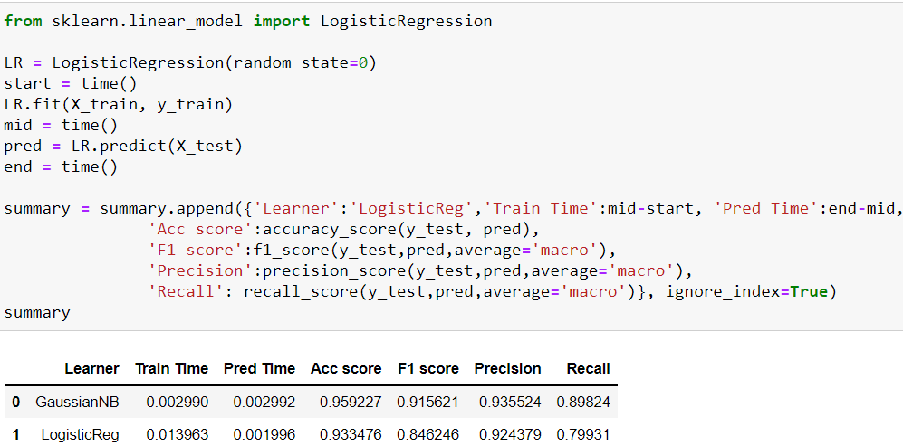

Slide 45
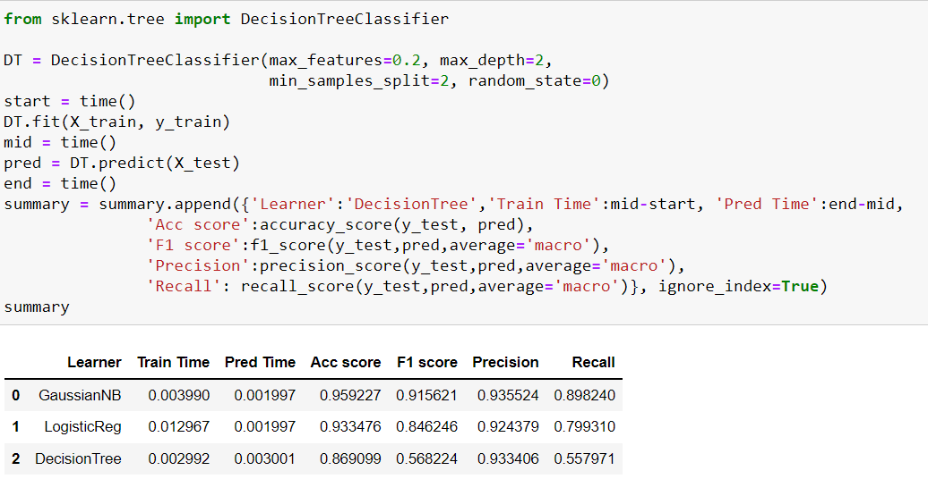

Slide 46
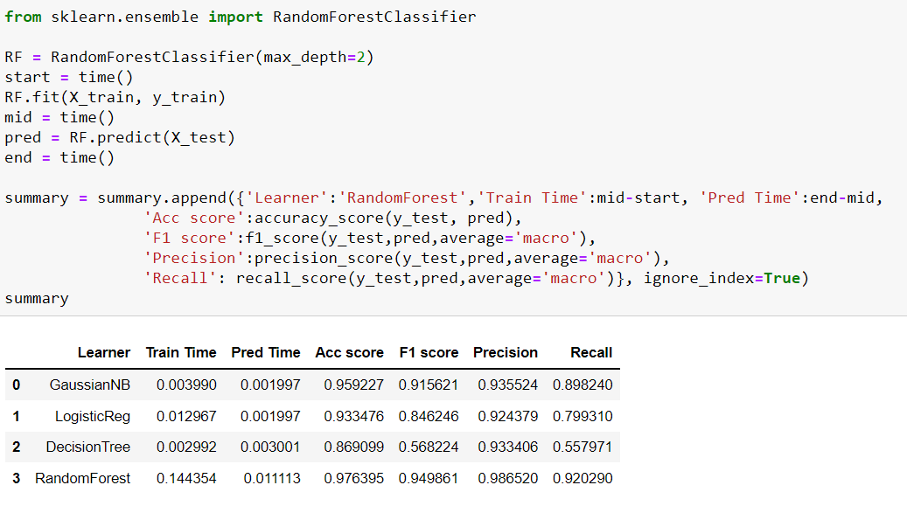

Slide 47
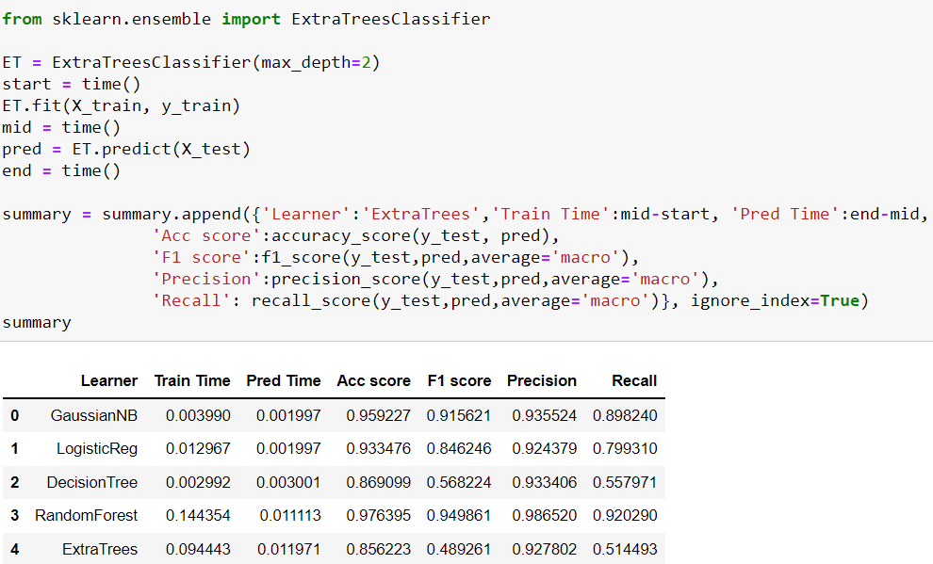

Slide 48
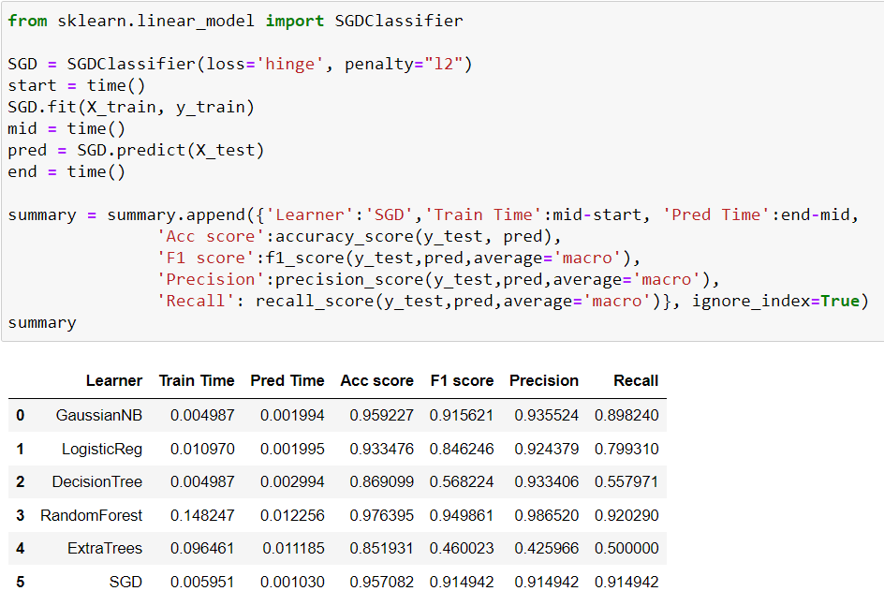

Slide 49
